Slide 1
IBM University Engagement Project Submission
“Exploring the Power of Agentic AI with IBM Granite and LangFlow”

Slide 2


Project Title – SmartRecipe AI: RAG-Based Recipe Preparation Agent
Domain of Project – Healthcare / Nutrition & Lifestyle AI
Student Name | Recent Passport Photo | Email ID | Mobile number [WhatsApp]
Savio Chacko Xavier |  | saviochackoxavier@gmail.com | 6235378348
Recommended font style and size:
Font Style: Arial
Font Size (Heading): 28
Font Size (Content): 20

Slide 3
Problem Statement -
Problem Statement : AICTE Problem Statement No. 16 – Recipe Preparation Agent
The Challenge
Households routinely discard usable food because people do not know what to cook with ingredients already available. Generic recipe search demands exact matches, overlooks dietary preferences, and offers little help when an ingredient is missing.
The Objective
Build SmartRecipe AI, an AI-powered Recipe Preparation Agent that helps users prepare practical meals from available ingredients using RAG, IBM Granite, and Langflow. The system supports dietary preferences, substitutions, serving-size adjustment, and clear step-by-step guidance.

Slide 4
Proposed Solution -
Proposed Solution: SmartRecipe AI – RAG-Based Recipe Preparation Agent
SmartRecipe AI is built using Langflow, IBM watsonx.ai, and IBM Granite models (ibm/granite-3-8b-instruct). A Retrieval-Augmented Generation pipeline queries a custom recipes.csv knowledge base and passes relevant recipe context to Granite.
The agent generates a practical, personalized recipe using the user’s available ingredients. It includes automated serving-size scaling, vegetarian/vegan preference handling, missing-ingredient substitutions, and concise cooking instructions.
The local Python/Pandas reference implementation validates retrieval logic, while scale_recipe.py demonstrates serving-size adjustment.

Slide 5
Technology Used
Langflow platform – visual design and orchestration of the agent workflow.
IBM Granite Model – ibm/granite-3-8b-instruct via IBM watsonx.ai for reasoning, recipe pairing, and personalization.
IBM Cloud / watsonx.ai – project infrastructure and secure model execution.
Custom RAG Knowledge Base – structured recipes.csv repository used for grounded retrieval.
Python / Pandas – local retrieval reference implementation and serving-size scaling utility.

Slide 6
Langflow component Used -
1) Chat Input – Where the user types available ingredients and preferences (e.g. "rice, tomato, onion, no dairy").
2) Prompt Template – Combines the user's ingredients with the retrieved recipe context and generation instructions.
3) File / Loader component – Loads the curated recipes.csv knowledge base used for retrieval.
4) IBM watsonx.ai Model component (Granite-3-8B-Instruct / Granite-4.0-8B-Instruct) – Generates the final recipe, substitutions, and tips.
5) Chat Output – Displays the AI-generated, step-by-step recipe to the user.
6) If-Else / Conditional component (optional) – Flags when an essential ingredient is missing and asks a quick follow-up question.
1) Chat Input – Users enter ingredients, dietary preferences, and meal requirements.
2) Prompt Template – Combines system instructions, user request, and retrieved recipe context.
3) IBM watsonx.ai Model Component – Configured with ibm/granite-3-8b-instruct.
4) Chat Output – Displays the structured, step-by-step recipe and substitutions.
5) File / Data Component – Ingests and queries the custom recipe CSV knowledge base.

Slide 7
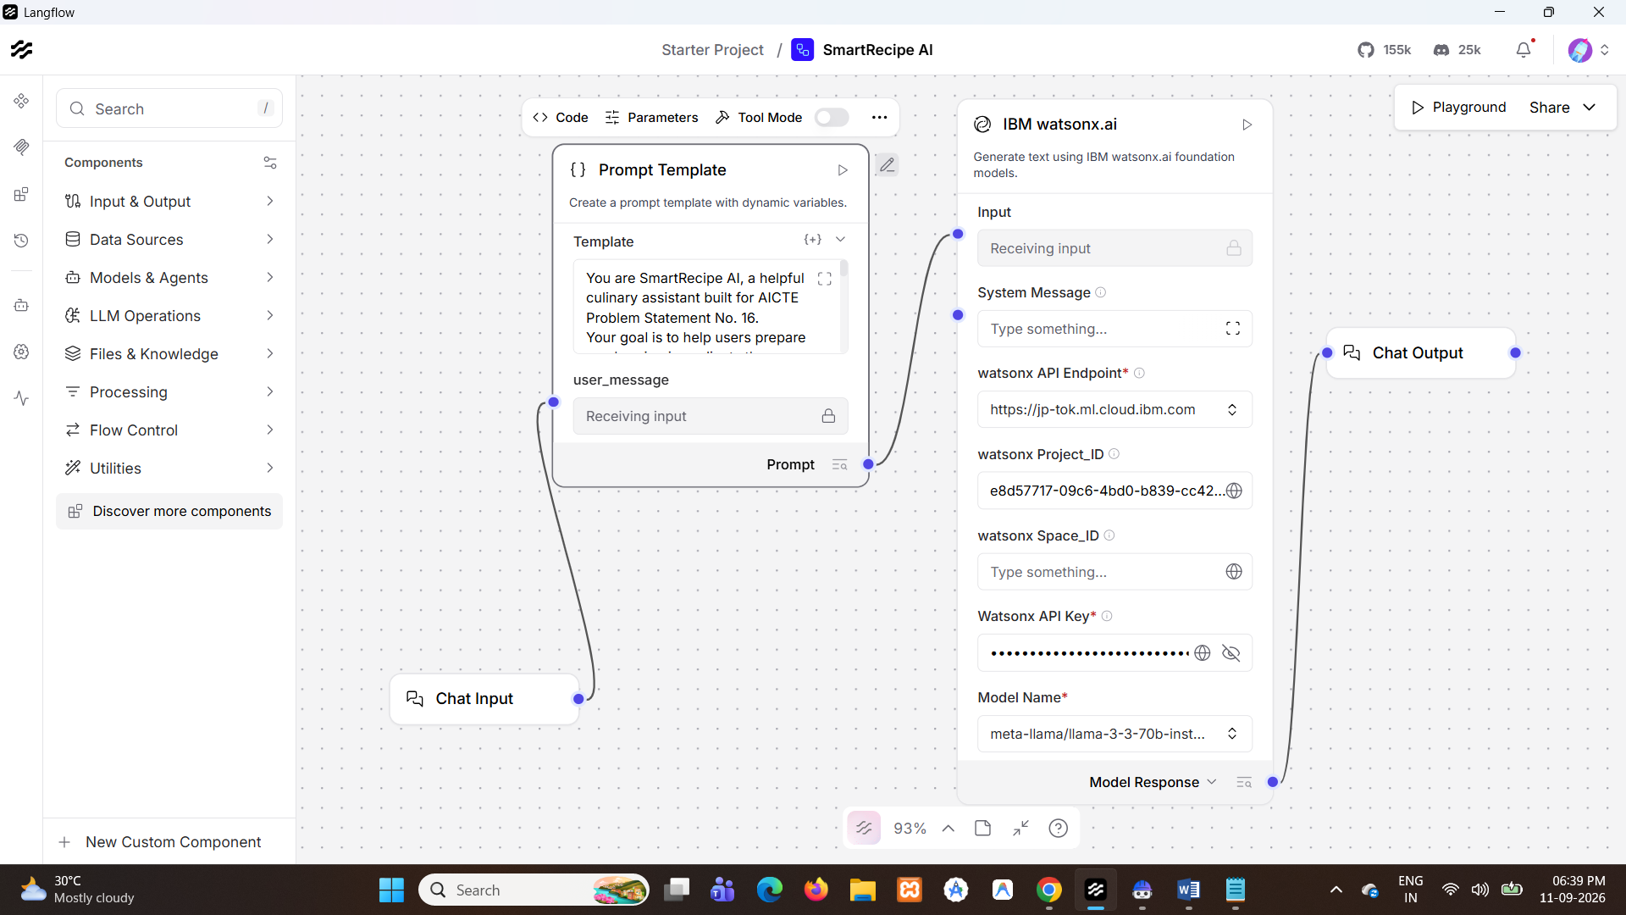
Langflow workflow -
Langflow canvas execution

Slide 8
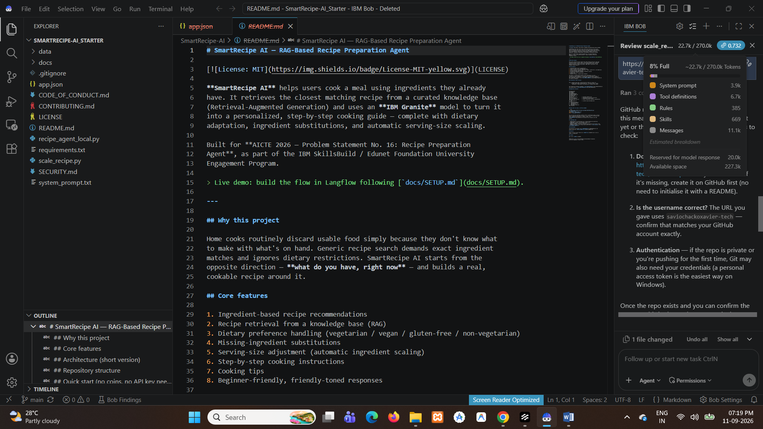
Architecture blueprint
Langflow workflow
VS Code architecture / implementation

Slide 9
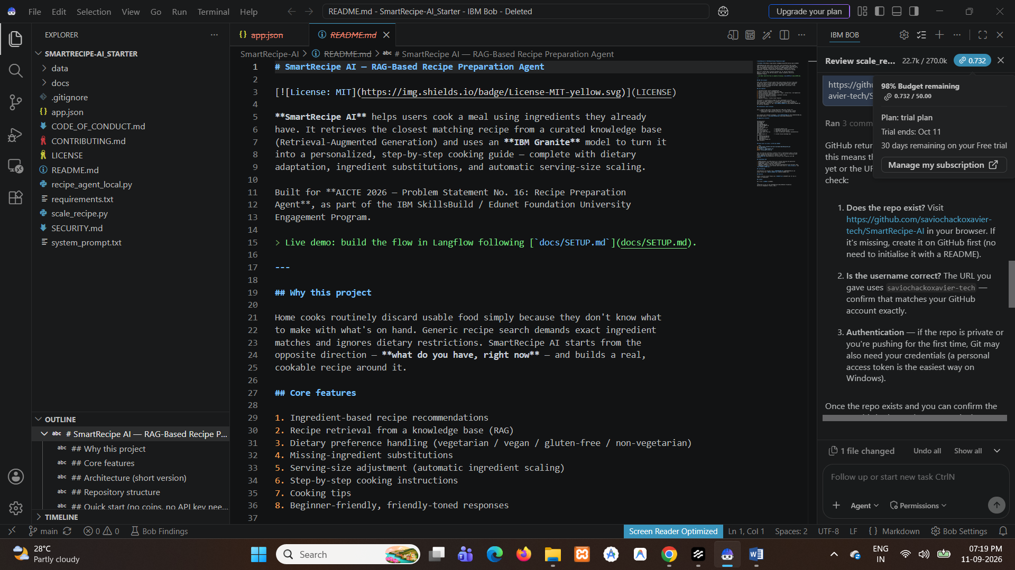
Role of Agentic AI in the solution
Role of Agentic AI in the SmartRecipe AI Agent
Agentic AI starts from what the user has available and builds a cookable recipe around it. It matches ingredients against dietary constraints, retrieves grounded recipe context, calculates serving adjustments, and structures the result into a beginner-friendly guide.
When a user adds a constraint such as vegetarian or vegan, the next response reflects it. When an ingredient is missing, the agent proposes a practical substitution instead of failing. This makes the system a context-aware cooking assistant that supports healthier lifestyle decisions and reduces food waste.
Serving-scaling implementation evidence

Slide 10
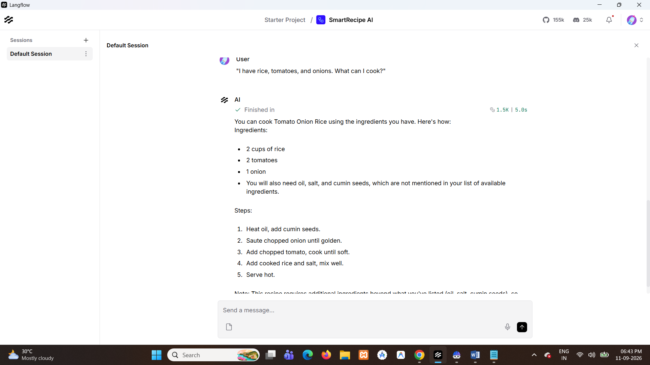
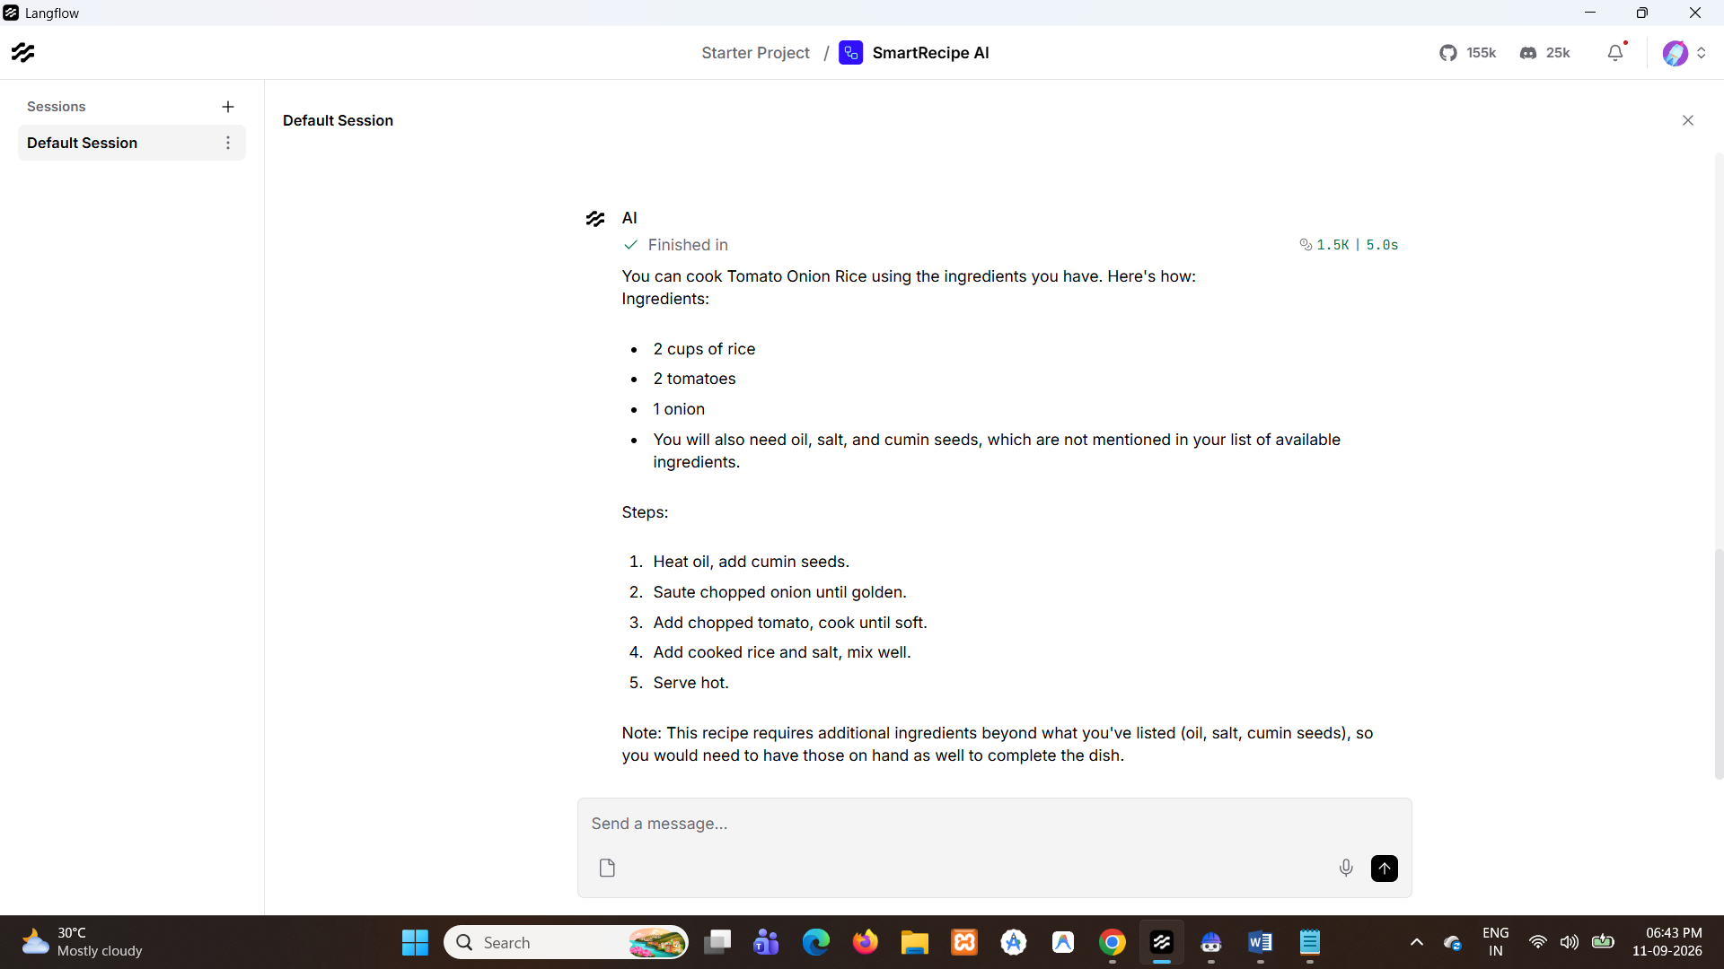
Token Usage
Token Usage / Implementation Verification

Slide 11
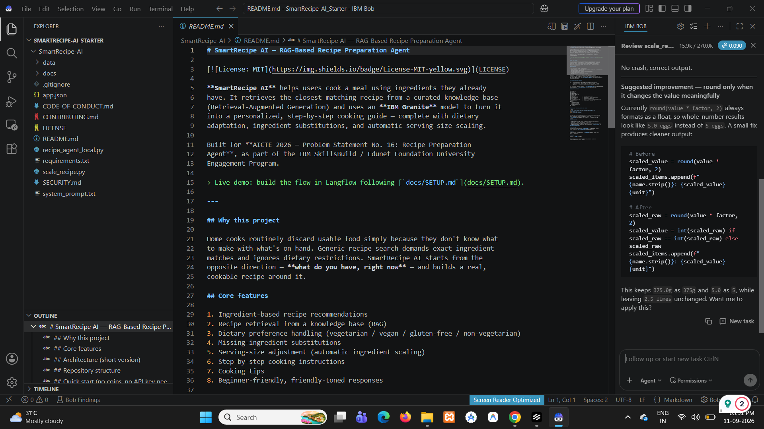
Novelty and Uniqueness
SmartRecipe AI is distinctive because it combines:
Ingredient-First Discovery – Generates meals from available inventory, directly addressing food waste.
Lightweight RAG – Retrieves from a compact, curated CSV knowledge base before generation.
Automated Scaling – scale_recipe.py adjusts ingredient quantities for the requested serving size.
Dietary Personalization – Supports vegetarian/vegan preferences and practical substitutions.
Evidence-Based Build – The screenshots document VS Code project structure, Langflow execution, and generated recipe outputs.
VS Code project structure and implementation

Slide 12
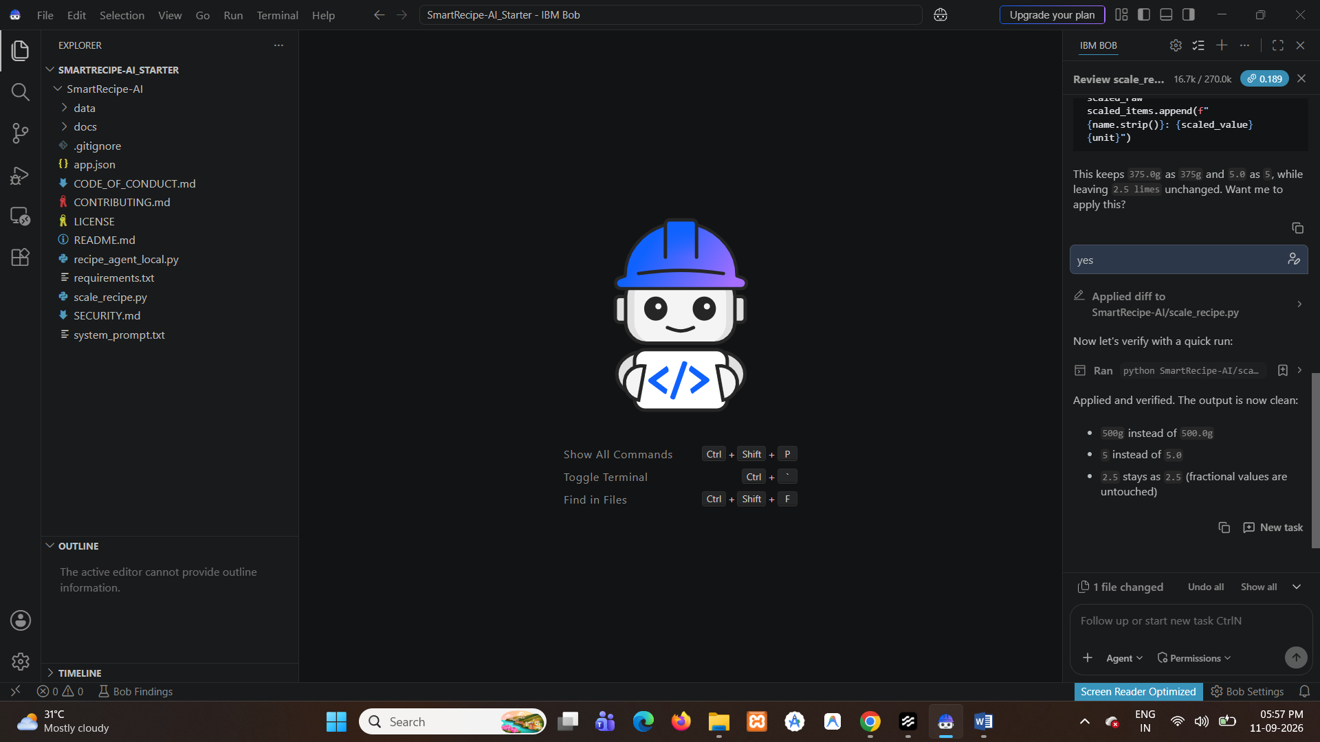
Git Hub Link
Working GitHub Repository:
https://github.com/saviochackoxavier-tech/SmartRecipe-AI
Files Included:
1) app.json – exported Langflow flow configuration
2) README.md – documentation and setup guide
3) data/recipes.csv – custom recipe knowledge base
4) scale_recipe.py, recipe_agent_local.py, and requirements.txt
The public repository should contain the real exported flow, problem-statement PDF, final presentation, and supporting files.
·
·
·
Project repository evidence

Slide 13
Future Scope
1. Smart Pantry Integration – Connect the agent to IoT refrigerators or mobile inventory apps to track expiring ingredients.
2. Multimodal Input – Let users photograph an open refrigerator shelf and receive recipe options through image recognition.
3. Multilingual & Voice Support – Add regional-language and voice interaction for broader accessibility.
4. Grocery-List Integration – Generate a shopping list for missing ingredients and connect to local grocery services.

Slide 14
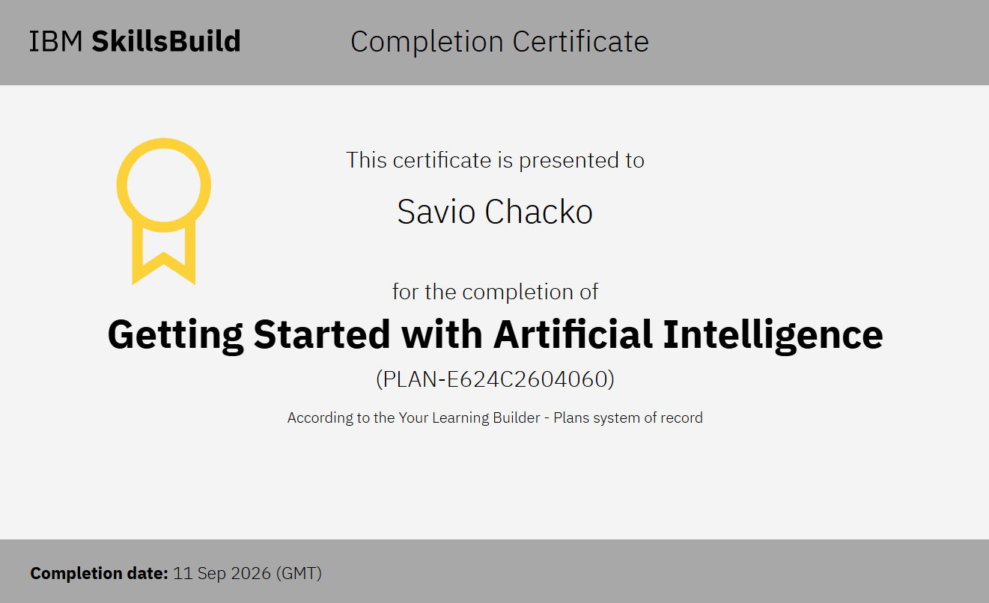
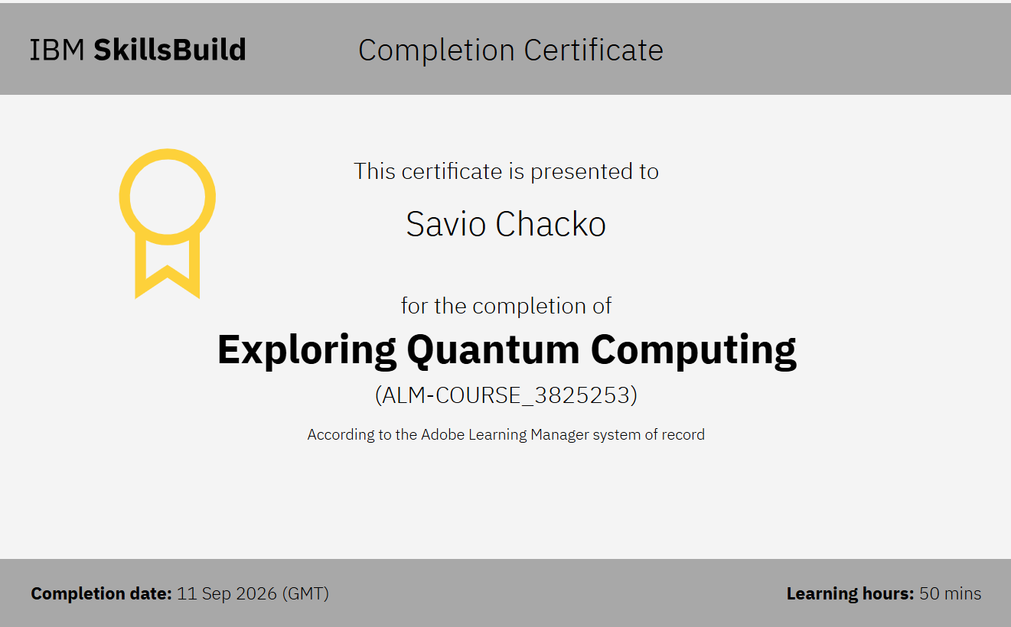
Certificates Earned:
Getting Started with Artificial Intelligence
Exploring Quantum Computing

Slide 15
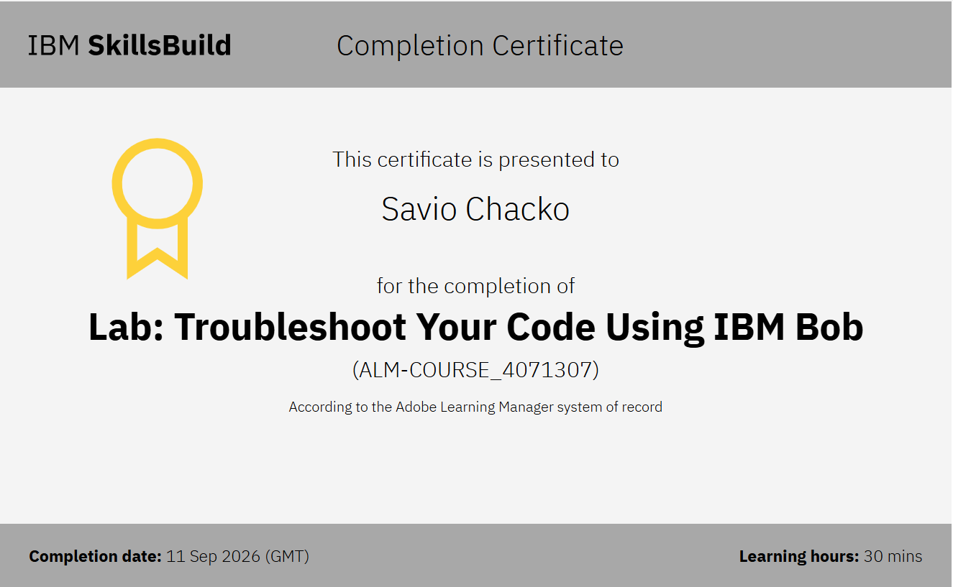
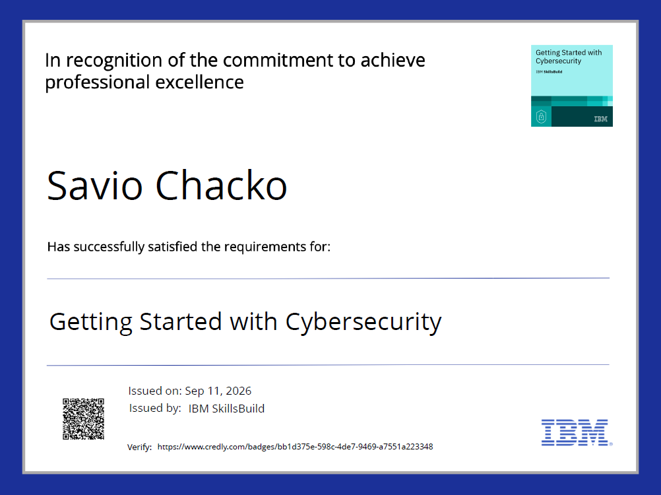
Certificates Earned:​
Lab: Troubleshoot Your Code Using IBM Bob
Getting Started with Cybersecurity

Slide 16


